Slide 1


Cocoa Flower and Cocoa Pod Detection model using Deep Learning
- Bikram Regmi
- Mina Baidhya
- Prabhat Paudel
MS/ME Geoinformatics
Kathmandu University
Third Semester
Deep Learning in Remote Sensing
(GEOI 502)
January 25, 2026

Slide 2
Outlines
Introduction
Objective
Dataset Description
Data Augmentation
Cocoa Flower and Cocoa Pod Detection Model Architecture
Experimental Results
Summary and Conclusion
Limitations and Future Work

Slide 3
Introduction
Object detection identifies what objects are present and where they are in an image
Outputs include boundin boxes, class labels, and confidence scores
Used in agriculture, autonomous vehicles, medical imaging, and surveillance
Monitoring cocoa flowers and pods is essential for yield estimation
Manual inspection is labor intensive and subjective
Automated vision-based analysis supports precision agriculture
Deep learning enables robust object detection in complex field environments
Region-based Convolutional Neural Network
Foundation of Fast and Faster R-CNN

Slide 4
Objective
To develop an object detection pipeline for cocoa flowers and pods
To perform accurate localization using bounding boxes
To address the challenge of limited annotated data
To maintain annotation consistency after augmentation
Use R-CNN based deep learning

Slide 5
Dataset Description
Total original images. 18
Data source: Field collected images provided by external contributors (Arun Pratihast )
Target classes: Flower & Cocoa pod
Labling Format: .XML with labling software
Limitation in the Dataset
Very small number of annotated samples
High background variability in field images
Risk of overfitting during deep learning training
Need for careful handling of bounding box annotations

Slide 6
Data Augmentation
Data Augmentation Strategy
Label consistent image augmentation applied
Bounding boxes transformed together with images
Invalid bounding boxes automatically filtered
Augmented data remains compatible with object detection models
Data Augmentation Techniques
Geometric transformations: Horizontal and vertical flipping, Rotation, Translation, and scaling
Color and illumination variation : Brightness, contrast, hue, saturation
Noise and blur effects: RGB shift, motion blur, Gaussian noise
Random crop followed by resizing

Slide 7
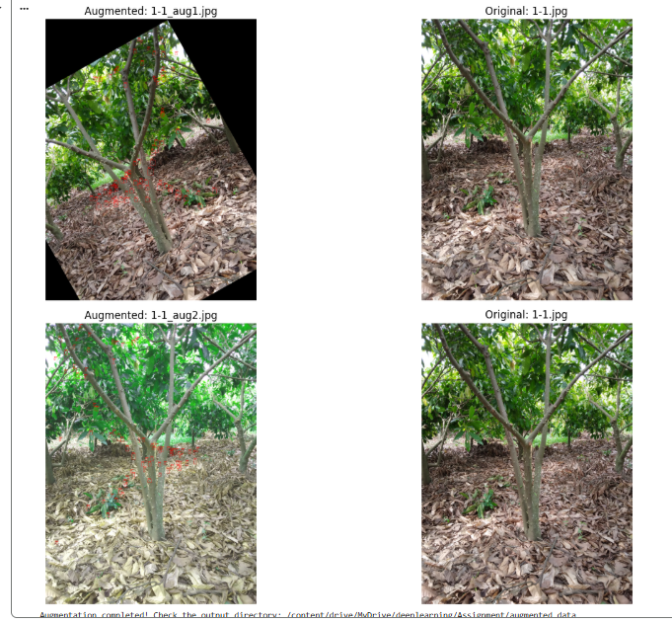
Data Augmentation
Data Augmentation Results
Original images: 18
Total augmented dataset : 72 images

Slide 8
Quality Control and Validation
Data Augmentation
Bounding boxes clipped to image boundaries
Minimum bounding box size enforced
Invalid annotations removed automatically
.XML annotations validated after augmentation

Slide 9
Cocoa Flower and Cocoa Pod Detection Model Architecture
Faster R CNN two stage object detector (coca pods and flower)
Pretrained weights from COCO dataset
Detection head adapted for two object classes and background
What is R-CNN?
R-CNN stands for Region-based Convolutional Neural Network
First deep learning model to combine region proposals + CNNs
Designed to improve localization accuracy compared to traditional methods

Slide 10
Cocoa Flower and Cocoa Pod Detection Model Architecture
Working Principle of R-CNN
Generate region proposals using Selective Search
Resize each region to a fixed size
Extract features using a Convolutional Neural Network (CNN)
Classify objects using a classifier
Apply bounding box regression for refinement

Slide 11
Cocoa Flower and Cocoa Pod Detection Model Architecture
Overall Workflow
Input Images
↓
Image Annotation (LabelImg)
↓
Data Augmentation & Transforms
↓
R-CNN / Faster R-CNN Model Training
↓
Validation & Testing
↓
Detected Objects + Performance Metrics
Training pipeline flow
Load Dataset
↓
Forward Pass (CNN + Region Proposals)
↓
Loss Calculation
↓
Backpropagation
↓
Model Weight Update

Slide 12
Cocoa Flower and Cocoa Pod Detection Model Architecture
Training Configuration
Framework: PyTorch and Torchvision
Training epochs: 100 epochs
Execution environment: Google Colab GPU

Slide 13
Experimental Results
Evaluation performed on validation dataset with annotations
Intersection over Union used for matching predictions and ground truth
Confidence threshold score =0.55
IoU threshold =0.55
Metrics reported
  --- Calculating Metrics (IoU Thresh: 0.55, Score Thresh: 0.55) ---
  True Positives : 360
  False Positives: 86
  False Negatives: 590
  ------------------------------
  Precision : 0.8072
  Recall : 0.3789
  F1-Score : 0.5158
  ------------------------------

Slide 14
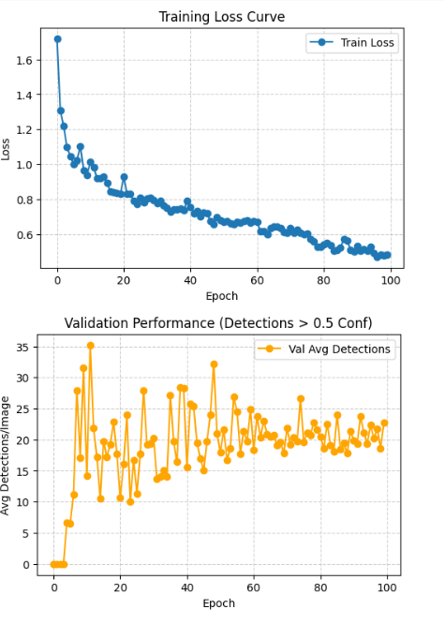
Experimental Results
Training loss shows consistent convergence behavior
Model successfully learns object localization
High precision achieved under strict IoU threshold
Qualitative results demonstrate accurate bounding box placement

Slide 15
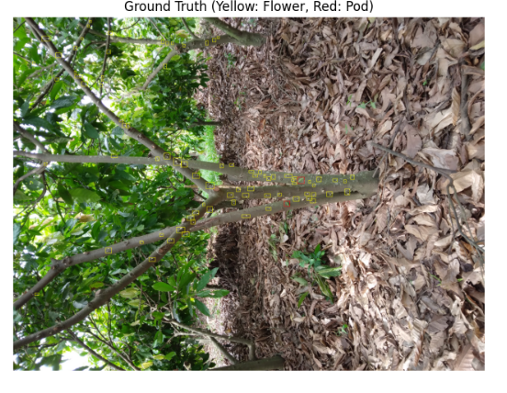
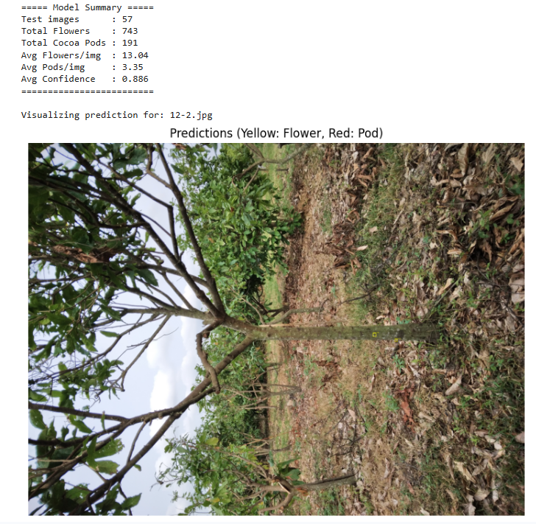
Experimental Results

Slide 16
Performance Analysis
Detection Accuracy (Image 1_2.jpg)
Object Class | Manual Count (Ground Truth) | AI Model Detection | Accuracy vs Manual
Flowers | 55 | 42 | 76.36%
Cocoa Pods | 6 | 3 | 50.0%
Total Objects | 61 | 45 | 73.77%
Time Efficiency
Manual counting: 2 minutes (120 seconds)
AI processing: 0.114 seconds
AI is ~1,090 times faster than manual inspection
Enables processing of large datasets within seconds

Slide 17
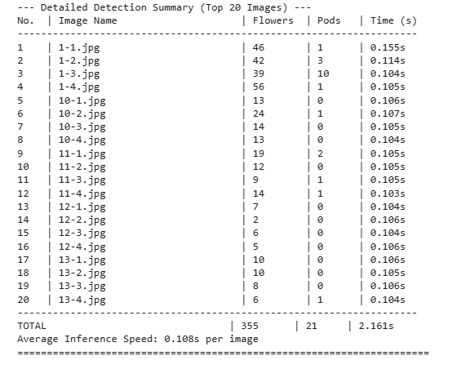
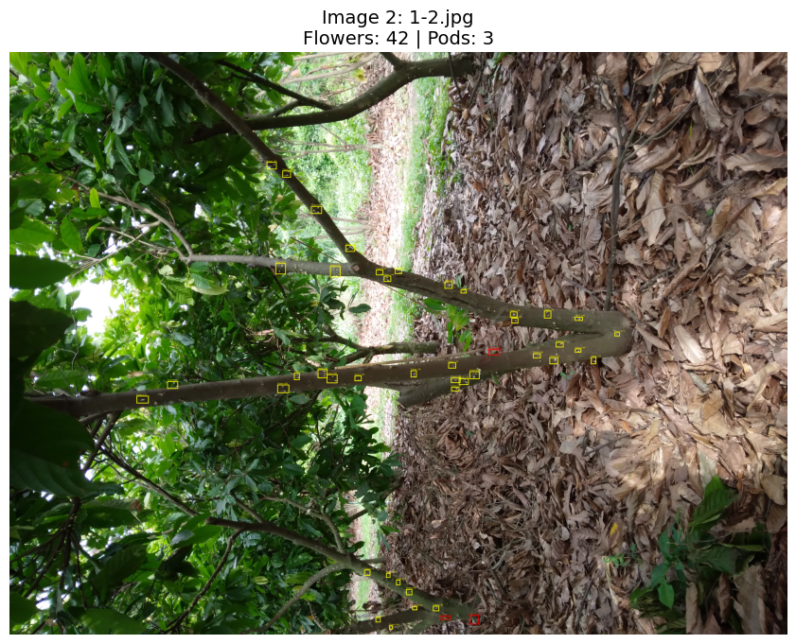
Visual Proof
Log showing inference time (0.114s) and detected counts
AI detection output for flowers and pods
Confirms model accuracy and extreme speed visually

Slide 18
Summary and Conclusion
Developed a deep learning system to detect flowers and cocoa pods from field images. Used a small Pascal VOC dataset. Applied data augmentation to improve model generalization.
Fine-tuned a Faster R-CNN with ResNet50 FPN backbone pretrained on COCO. Trained with 100 epochs, learning rate 0.005, batch size 2, in PyTorch on GPU.
Evaluated using precision, recall, and F1-score. Used IoU threshold 0.55 and confidence 0.55. Visualized predictions and per-image detection counts.
Created a full end-to-end pipeline for data preparation, augmentation, training, evaluation, and visualization.

Slide 19
Limitations and Future Work
Limitations
Extremely small original dataset
Image diversity of field conditions
Not suitable for real-time detection
Future work
Collection of larger annotated datasets
Standard evaluation using mean average precision
Deployment oriented lightweight detection models

Slide 20
Any Query?
>>>>>>>>>>>>>>>>>
Thank You!

